Slide 1
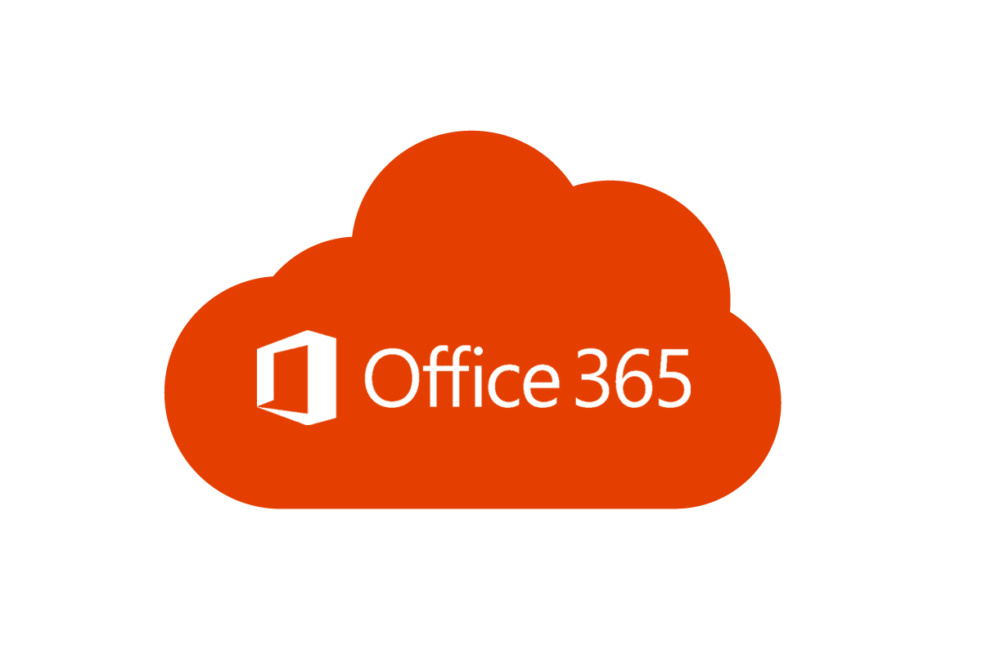
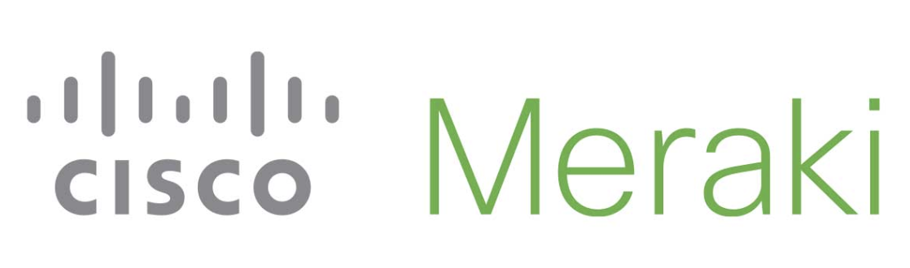

Performance-based routing to Microsoft Office 365 over Cisco Meraki SD-WAN.

Slide 2
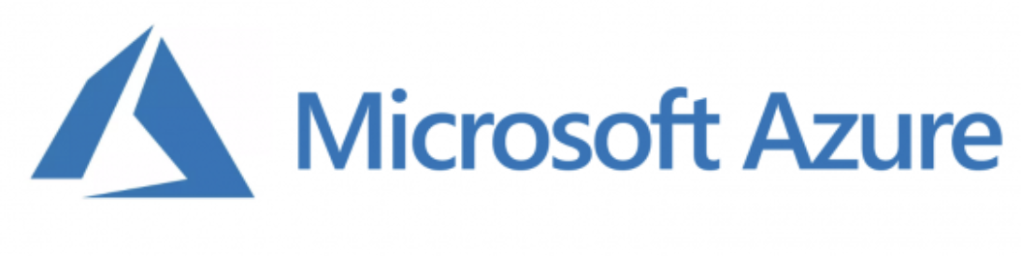



Scenario
To Office365 via WAN uplinks
MX VPN Hub
(Routed mode)
Internet
MX VPN Branch
Drawbacks:
Routing is fully controlled by ISPs,
Link preference does not take into account uplink performance.
Notes:
We recommend quickly going through this slide when you do your 3-minute presentation.

Slide 3
Solution
To Office 365 via Meraki Auto VPN
MX VPN Hub (Routed mode)
Internet
MX VPN Branch
Configuration:
Option 1: Send all Internet traffic to the Hub (exit hub),
Option 2: Manually advertise all Office 365 routes to all peers.
Notes:
During the 3-minute presentation, this can be explained as you go through the floor plan on slide 5.

Slide 4


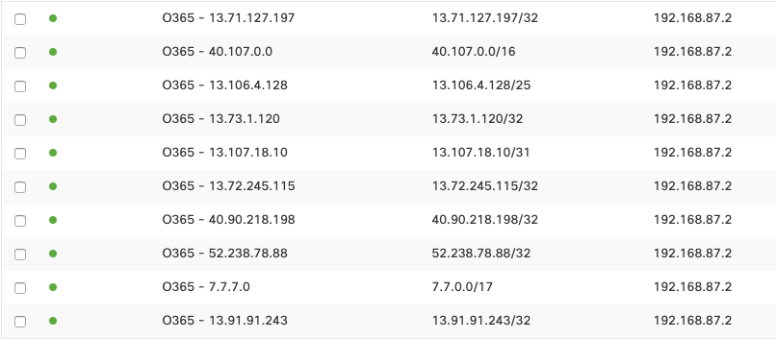
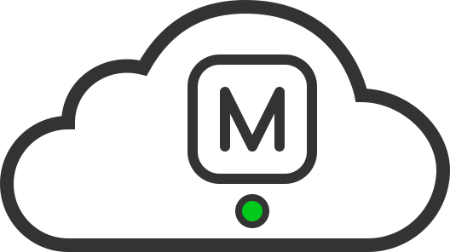

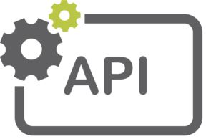
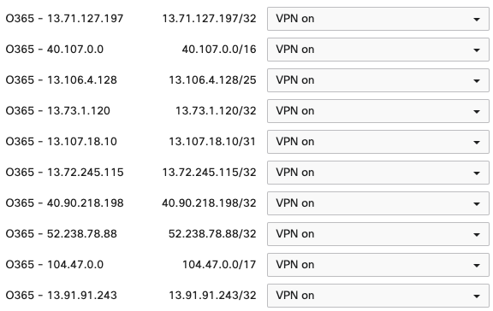

Automation
Static routes
GET
Data
GET
DELETE
Data
PUT
POST
Cisco Meraki
Cloud
office_365_subnets = [
'13.71.127.197/32',
'40.107.0.0/16',
'13.106.4.128/25',
'13.73.1.120/32',
'13.107.18.10/31',
'13.72.245.115/32',
'40.90.218.198/32',
'52.238.78.88/32',
'104.47.0.0/17',
'13.91.91.243/32'
]
current_mx_subnets = [
'13.71.127.197/32',
'40.107.0.0/16',
'13.106.4.128/25',
'13.73.1.120/32',
'13.107.18.10/31',
'13.72.245.115/32',
'40.90.218.198/32',
'52.238.78.88/32',
'7.7.7.0/17',
'13.91.91.243/32'
]
Site-to-Site VPN
Notes:
We recommended spending most of the 3 minutes on this slide.

Slide 5

Thank you!
https://github.com/SalnikovAndrey/performance-based-routing-to-office-365-over-meraki-sd-wan
Email: asalniko@cisco.com

